Slide 1
Kafka @ PayPal: Enabling 400 Billion Messages a Day
Kevin Lu, Na Yang and Maulin Vasavada

Slide 2
Agenda
PayPal
Kafka @ PayPal Today
The Beginning
Growth Spurt
Road to Kafka-as-a-Service
Future

Slide 3
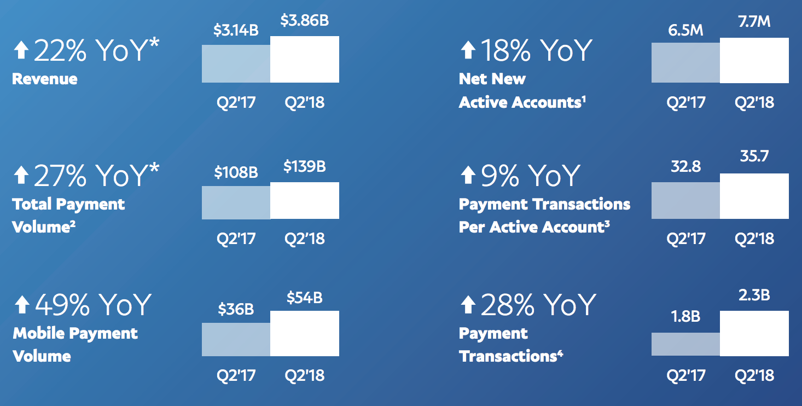
PayPal Growth
From https://www.paypal.com/us/webapps/mpp/stories/media-resources

Slide 4
Kafka @ PayPal Today
Overview
400+
Billion messages
per day
50+
Clusters
3000+
Topics
~7PB
Disk
Kafka Journey
0.8
0.9
0.10
1.1

Slide 5
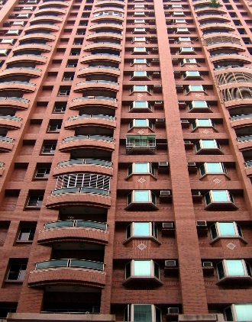
Kafka @ PayPal Today
Tech stack
Languages
Application Frameworks
Multi-Tenant
Gimel
Multiple Regions & Availability Zones

Slide 6
Data Pipelines
Frameworks
& Platforms
Use Cases
User behavioral tracking
Experimental
Merchant monitoring
Risk & compliance
Kafka
Gimel
Business Events
Application logs
Application metrics
Batch Processing
Real-Time Streaming

Slide 7
The Beginning…

Slide 8
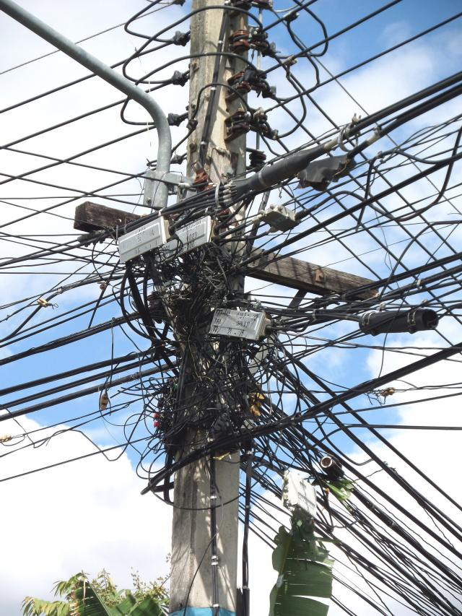
The Beginning
Individual teams set up their own clusters
Challenges
Duplicate work
Lack of Standardization
Inexperience with Kafka
No knowledge sharing

Slide 9
The Solution
Dedicated Kafka team

Slide 10
Growth Spurt!!!

Slide 11
Growth Spurt!
100B
1B
100M
2015
Dedicated Kafka Team
2016
Ecosystem Expansion
Early 2017
Massive Scale

Slide 12
Growth Challenges…
1. EVERYTHING was manual & bare metal
2. No visibility into cluster health
MONTHS to onboard a new use-case
TTD (time to detect) a broker failure:
24 hours
3. Issues
4. Support vs dev work
Long TTR (time to recover) of DAYS to a WEEK to resolve issues
Engineers/developers spent MORE time on support work vs dev work

Slide 13
Road to Kafka as a Service
Operational Dashboard & Client Visibility

Slide 14
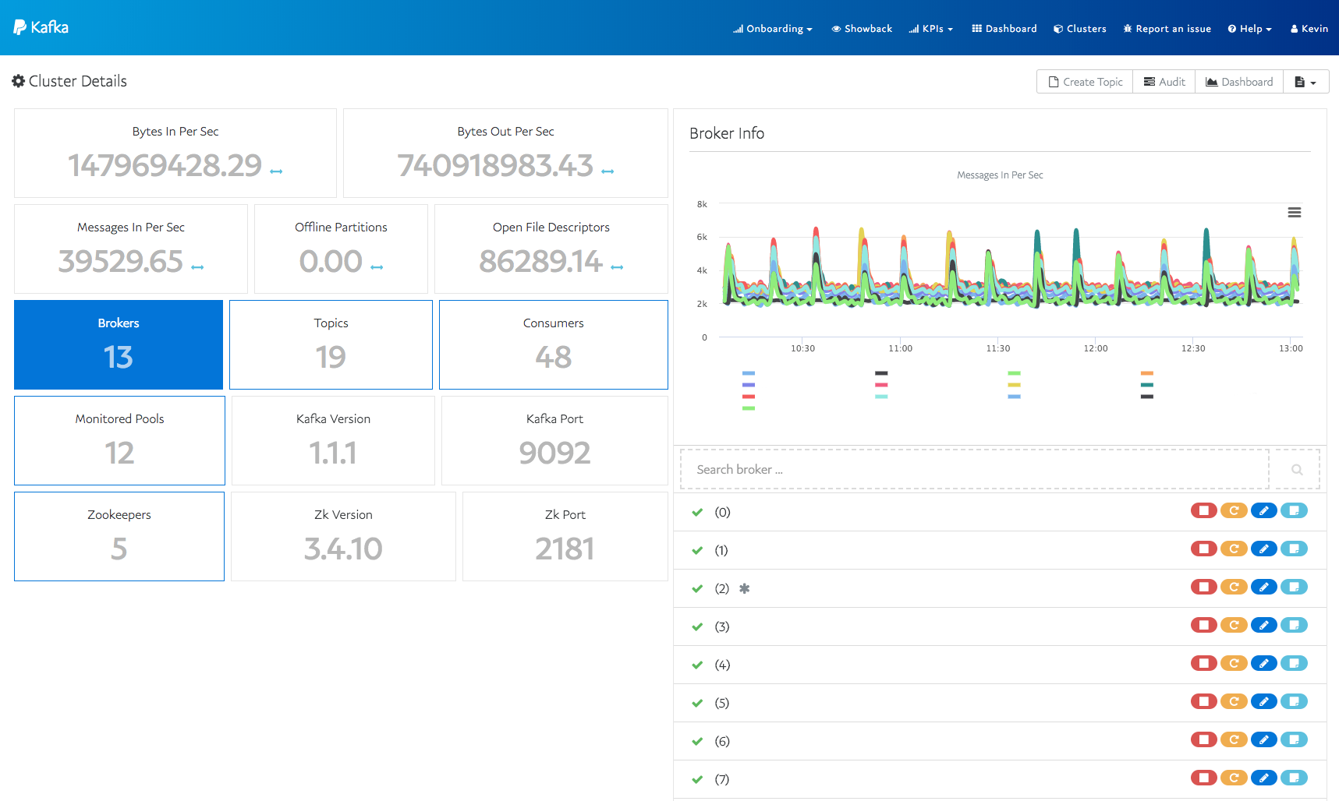
KafkaMon
A monitoring and operational dashboard
View cluster, topic, partition, consumer group info
Topic management (create, modify, repartition)
Broker/zookeeper deployment
MirrorMaker deployment
View logs

Slide 15
Availability and Customer KPIs
Our challenge
What is my topic availability?
What is my producer latency?
Will I get notified if something bad happens in my Kafka data pipeline?
…
What is my topic availability?
What is my consumer latency?
Will I get notified if something bad happens in my Kafka data pipeline?
…
Producer
Consumer
Producer
Consumer
Producer
Consumer
Cluster is up,
everything looks OK! ☺

Slide 16
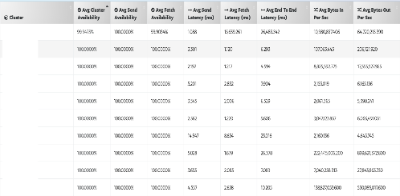
Availability and Customer KPIs
Our solutions
Canary producer
Canary
consumer
Producer
Consumer
Producer
Consumer
Send availability
Send latency
Send throughput
Fetch availability
Fetch latency
End-to-end latency
Fetch throughput
Over 4000 clients are monitored!
Time Series Database
Alerts
Dashboard

Slide 17
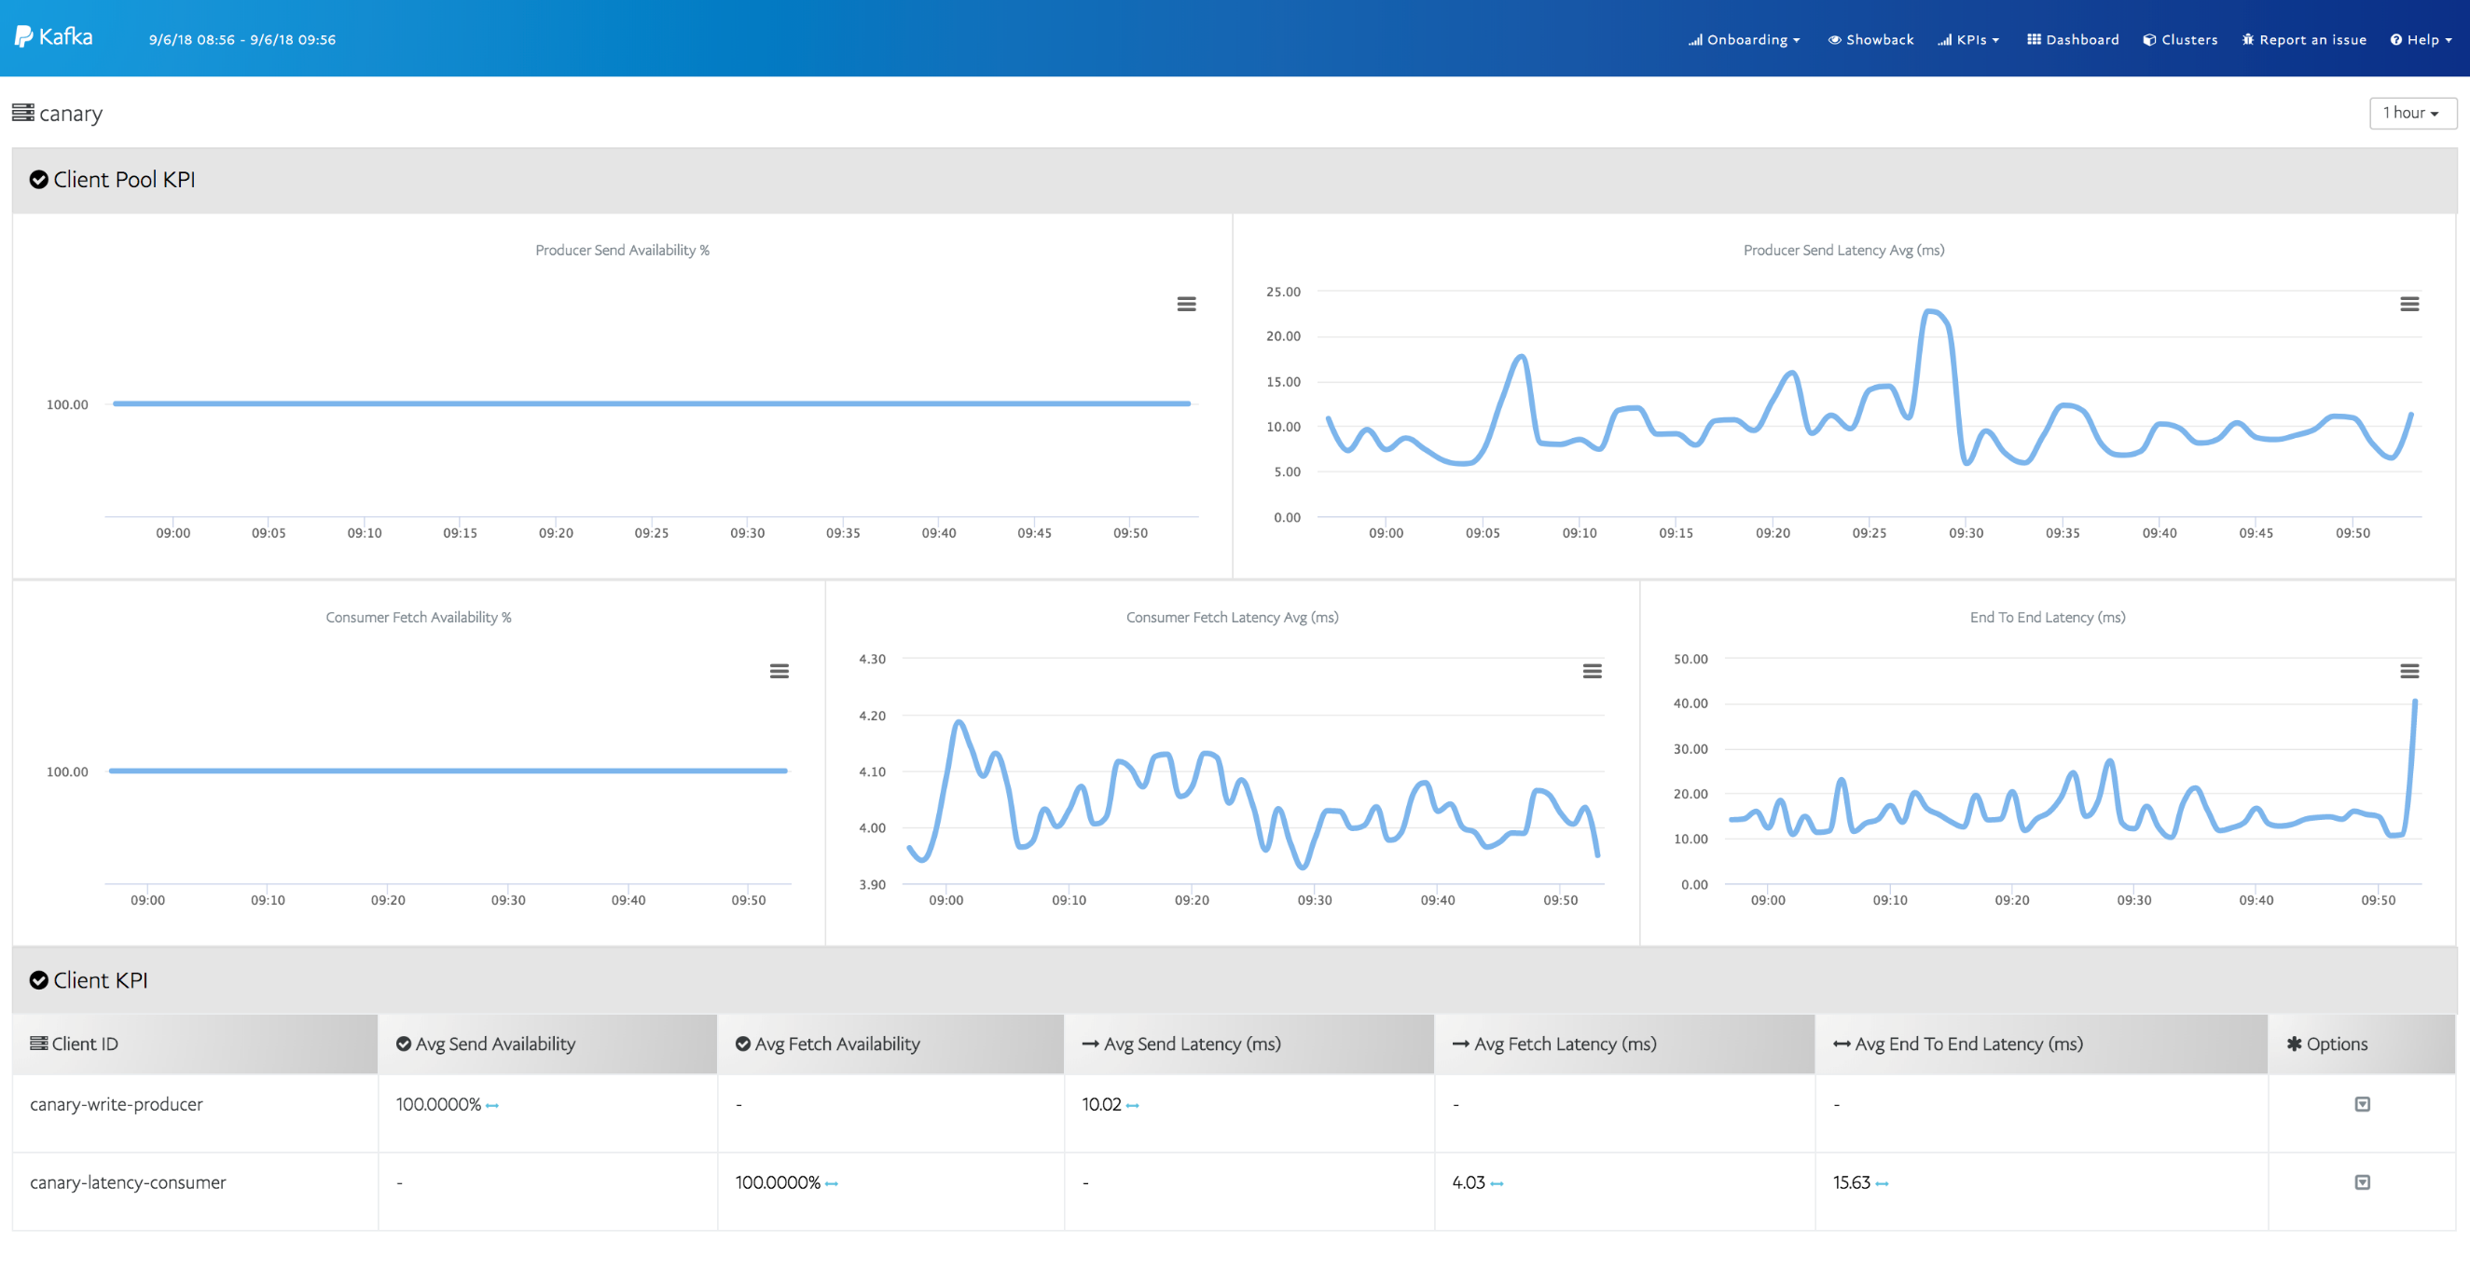

Slide 18
Is There Data Loss???

Slide 19
Is There Any Data Loss?
Producer
MM
Consumer
Is there any data loss during an outage?
How can we tell?

Slide 20
Data Loss Auditing
Producer
MM
Consumer
audit message
audit message
audit message
cluster: cluster_1
topic: Test
count: 180
type: producer
time_bucket_start_ms: 1501796200000
time_bucket_end_ms:
1501796260000
cluster: cluster_2
topic: Test
consumer_group_id: canary
count: 180
type: consumer
time_bucket_start_ms: 1501796200000
time_bucket_end_ms:
1501796260000
Data Loss Auditor
data loss
alerts

Slide 21
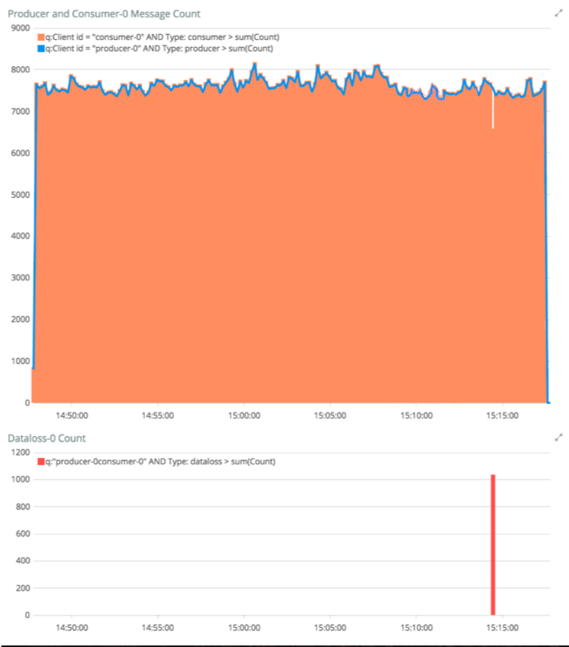
Data Loss Auditing
Data loss tracking dashboard
dataloss detected!

Slide 22
Road to Kafka as a Service
Onboarding and Capacity Management

Slide 23
Customer Onboarding
Web UI
Automated process
Customer
Kafka team
Kafka team
Kafka team
Customer
File ticket
Review ticket and do capacity approval
Create topic
Update ticket
Use Kafka
Request new hardware
Kafka team
Weeks
Onboarding time
Minutes

Slide 24
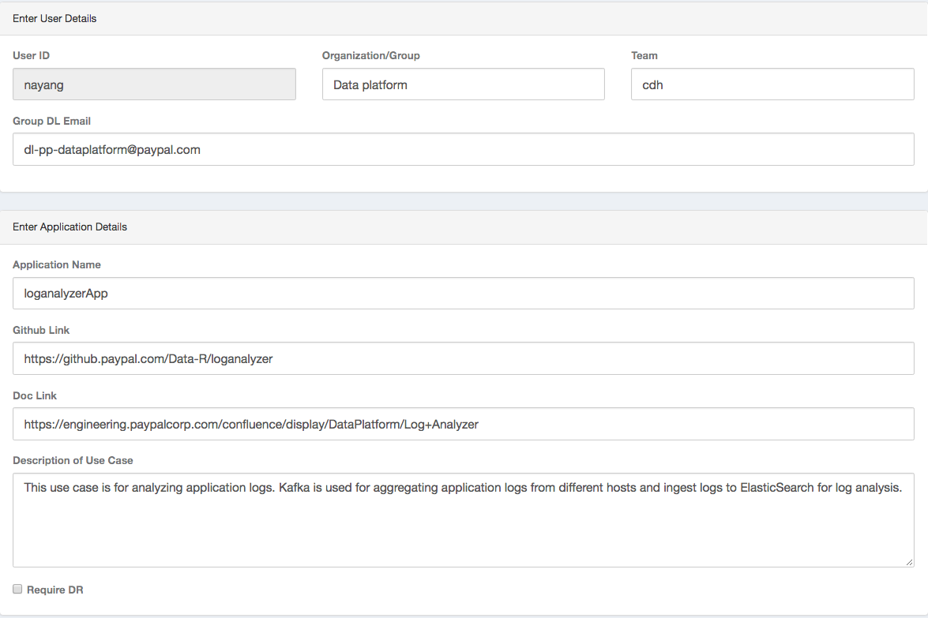
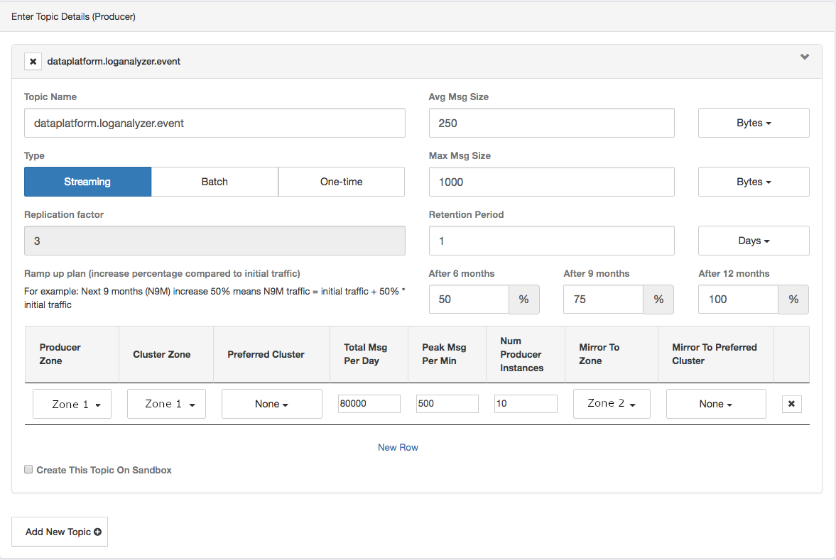
Self-service Onboarding
User and application metadata
Topic details

Slide 25
Capacity Management
~10TB
Memory
~7PB
Disk
~6tbps
Network
~3000
CPU
Tens of millions $ in hardware cost!

Slide 26
Capacity Management
Manage capacity based on individual cluster
Manage capacity based on data center
Capacity showback
used
unused
used
unused

Slide 27
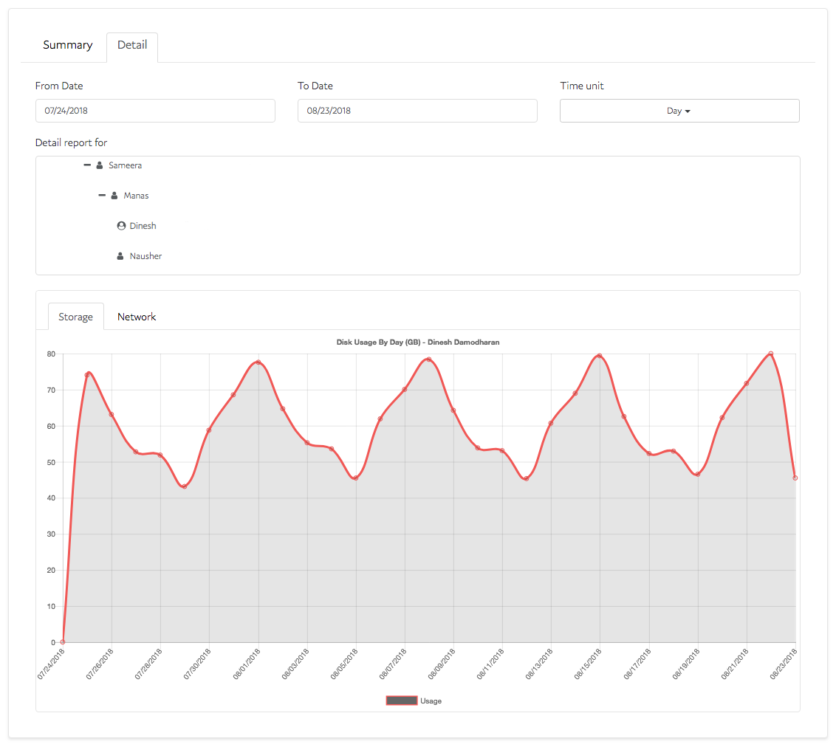
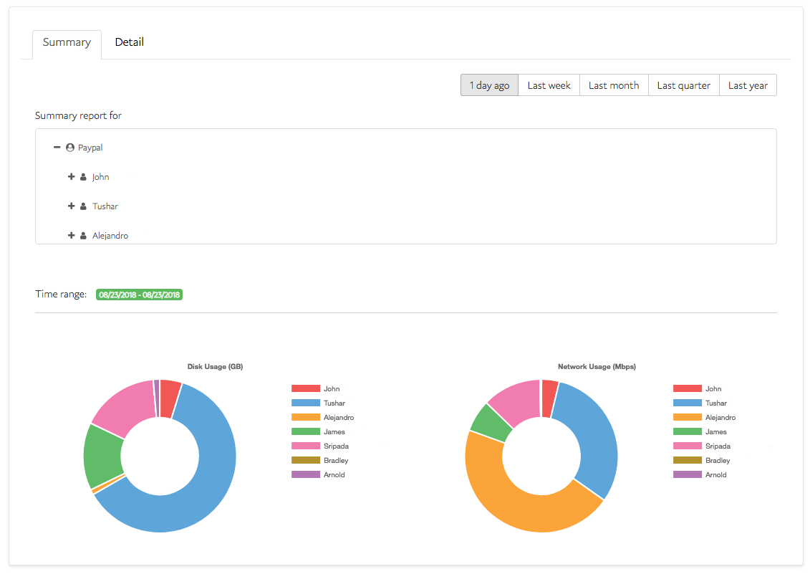
Capacity Showback
Organization Hierarchy
Organization Hierarchy
Customer used capacity
Customer used capacity by organization

Slide 28
Road to Kafka as a Service
Configuration Service & Control Plane
Notes:
No

Slide 29
Clusters uneven-utilization over time
Storage and Bandwidth Usage across clusters
Client-apps
Client-apps
{ highly utilized }
{ fairly utilized }
Client-apps
Client-apps
{ lightly utilized }
{ need to decommission }

Slide 30
Availability challenges
0% Send availability for some topics
0%/Low cluster availability upon Network switch or Power outage
Producer-1
T1
Producer-1
T1
T2
T2
Producer-2
T3
Producer-2
T3
Downtime
{ batch expired }
Days/Hours
Client-app-1
Client-app-1
T1
T1
T2
T2
Client-app-2
T3
Client-app-2
T3

Slide 31
Configuration Service
Client-app
4
T1
read/write
T2
PayPal Library
T3
1
3
{ T1,T2,T3 }
{ kafka properties }
Control & Data Plane
Configuration
service
2
read
Admin
service
metadata

Slide 32
Efficiency
Upon topic movement
Manual
Automated
Error prone
Streamlined
Unpredictable
Predictable
Several days/hours
Few mins

Slide 33
Kafka Control & Data Plane
Admin
Clients
Other Eco-systems
Control Plane
Presentation Layer
APIs
Admin
Service
MirrorMaker
Management
Configuration
Service
Capacity
Management
Showback
Management
Monitoring
Data Plane
Restricted Access
Zookeepers
Brokers
MirrorMakers
metadata
Notes:
Last but not the least,
Access to the Data plane consisting of our brokers, zookeepers, mirror-makers and the metadata is restricted to the control plane components only

Slide 34
Future
Automate client failover
Automate remediation
Contribute back to the community
Client side KPIs
Learnings

Slide 35
Conclusion
Measure client perceived availability
Abstract clusters from clients
Build metadata
Automate
Cluster deployment & configuration
Client-onboarding
Remediation processes
Make alerts actionable

Slide 36
Thank you!

